Slide 1
Computer Graphics: 2D – Transforms
Tommy Marrinan, PhD

Slide 2
Geometric Transforms
Affect position, size, and orientation of models
Only modifies vertices
Edges remain in tact

Slide 3
Translate
Move model to new location
Add offset to coordinates of all vertices
x’ = x + t_{x} y’ = y + t_{y}
Positive values for t_{x} will move the mode right (negative left)
Positive values for t_{y} will move the model up (negative down)

Slide 4
Scale
Shrink or enlarge model
Multiply coordinates by a scalar value
x’ = x · s_{x} y’ = y · s_{y}
Positive values > 1.0 will enlarge the model
Positive values between 0.0 and 1.0 will shrink the model
Negative values will invert the model
Note: scaling occurs about the origin

Slide 5
Rotate
Change orientation of a model
Rotate by angle 𝜃 counter-clockwise about the origin
x’ = x · cos(𝜃) – y · sin(𝜃) y’ = x · sin(𝜃) + y · cos(𝜃)
Where do those equations come from?

Slide 6

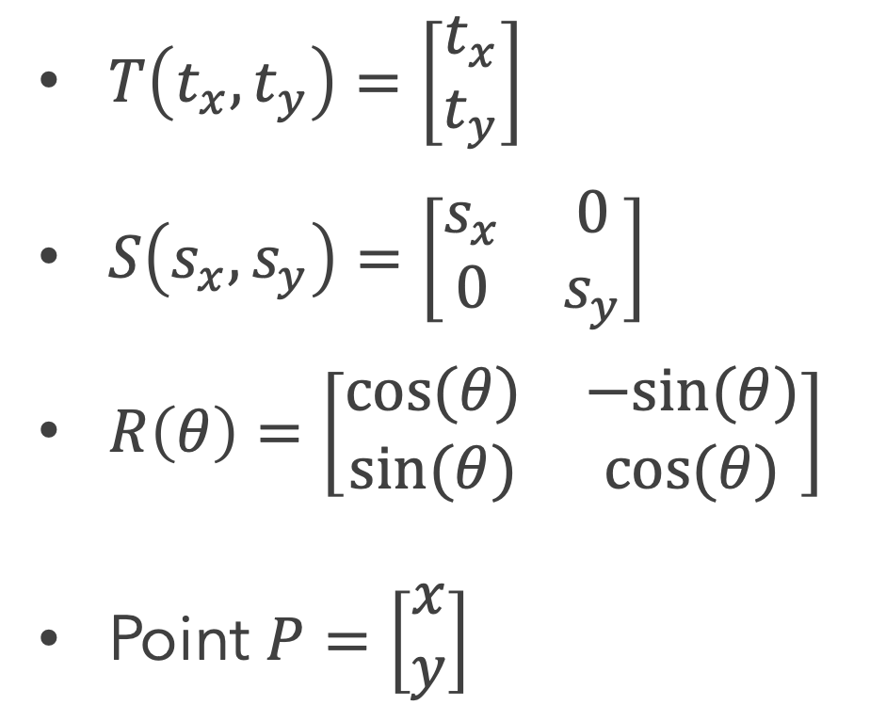
Matrix Form
$T\left(t_{x},t_{y}\right)=\left[\begin{matrix}t_{x} \\ t_{y}\end{matrix}\right]$
$S\left(s_{x},s_{y}\right)=\left[\begin{matrix}s_{x} & 0 \\ 0 & s_{y}\end{matrix}\right]$
$R\left(θ\right)=\left[\begin{matrix}cos⁡(θ) & −sin⁡(θ) \\ sin⁡(θ) & cos⁡(θ)\end{matrix}\right]$
Point $P=\left[\begin{matrix}x \\ y\end{matrix}\right]$
$P^{′}=T\left(t_{x},t_{y}\right)+P$
$P^{′}=S\left(s_{x},s_{y}\right)⋅P$
$P^{′}=R\left(θ\right)⋅P$

Slide 7
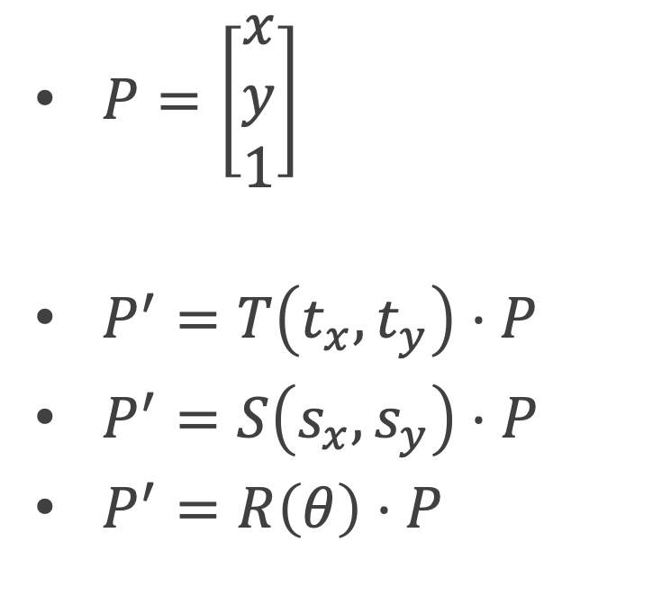
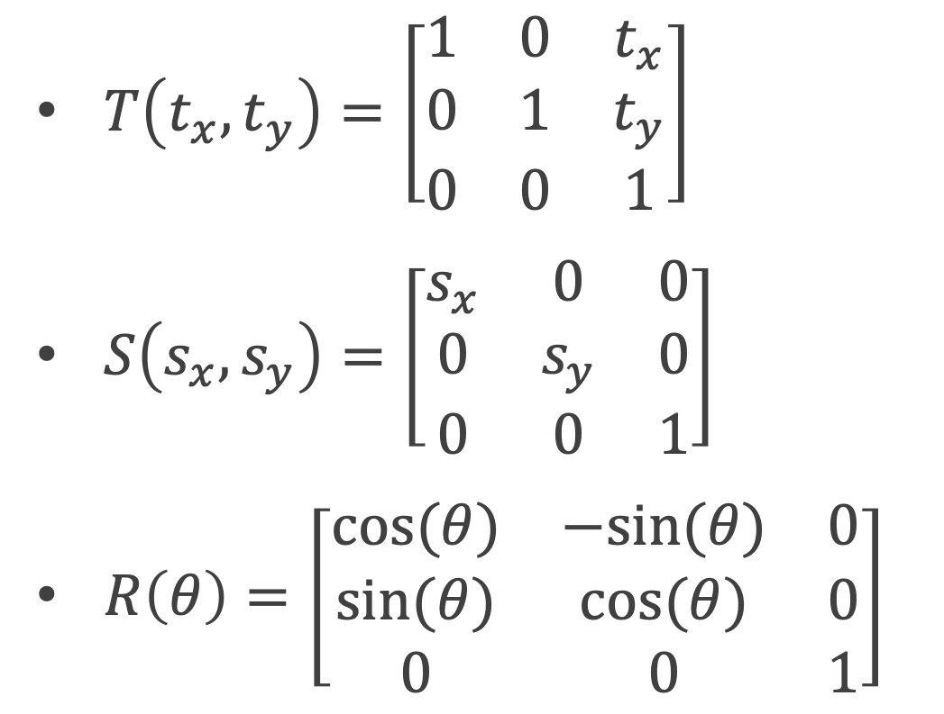
Homogeneous Coordinates
$T\left(t_{x},t_{y}\right)=\left[\begin{matrix}1 & 0 & t_{x} \\ 0 & 1 & t_{y} \\ 0 & 0 & 1\end{matrix}\right]$
$S\left(s_{x},s_{y}\right)=\left[\begin{matrix}s_{x} & 0 & 0 \\ 0 & s_{y} & 0 \\ 0 & 0 & 1\end{matrix}\right]$
$R\left(θ\right)=\left[\begin{matrix}cos⁡(θ) & −sin⁡(θ) & 0 \\ sin⁡(θ) & cos⁡(θ) & 0 \\ 0 & 0 & 1\end{matrix}\right]$
$P=\left[\begin{matrix}x \\ y \\ 1\end{matrix}\right]$
$P^{′}=T\left(t_{x},t_{y}\right)⋅P$
$P^{′}=S\left(s_{x},s_{y}\right)⋅P$
$P^{′}=R\left(θ\right)⋅P$

